Slide 1
Secrets of Compliance
Client Webinar Series
Time to Reach New Heights
July 14, 2016

Slide 2
Agenda
Objective: Understanding Spitfire’s Compliance Engine
Setup
Two Levels
Vendor-level
Subcontract-level
Compliance Types
User Defined Types
% paid
Effective & Expiration date
Received Date
Enforcement
Auto
Block
Warn
Every Day Use
Blocks Pay Request Approval
Compliance Notification direct to Vendor
Alerts to you and/or Vendor
Compliance Log
Out of Compliance only
All Compliance Items

Slide 3
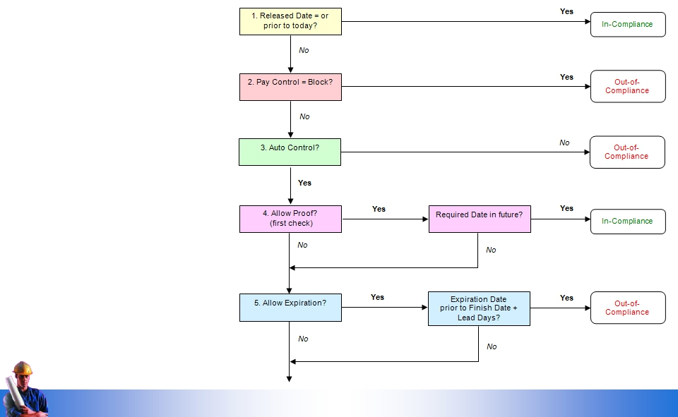
How it Works
Note: Compliance
Types set to
Warn are not
considered

Slide 4
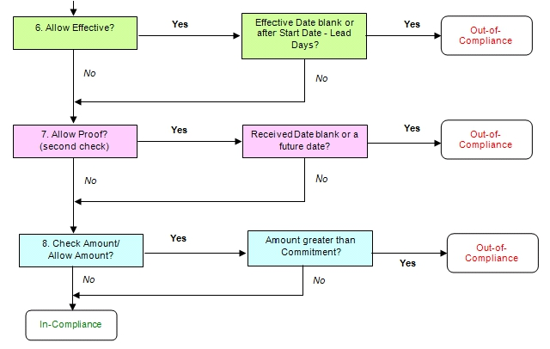
How it Works
Note: Not all checkpoints apply to each Compliance Item.
Checkpoints are configured in the Compliance Type

Slide 5
How it Works
% Complete Compliance Item
Only applies if “out of compliance”
Blocks “approval” of Pay Request if Prior + Current Pay Request Amount exceed % setting

Slide 6
Setup
Step 1: Prepare
Gather information
Step 2: Use the Code Maintenance tool
Create subtypes for your vendors and
subcontractors
Step 3: Use the UI Configuration tool
Customize Vendor and Commitment Doc types
Step 4: Use the Compliance Types tool
Edit existing Compliance types
Create new Compliance types
Create automatic workflow for your
Compliance Items
Step 5: Use ICTOOL
Turn on Automatic Workflow on the sfATC tab of the Spitfire Installation and Configuration tool
Step 6: Use the Roles tool
Create a Role to receive the out-of-compliance Alerts
Step 7: Use the Alert Subscriptions tool
Set up a subscription for out-of-compliance
Alerts
Step 8: Use the Doc Type tool
Activate the Compliance Notification Doc
Step 9: Use the Rules Maintenance tool
Set up the text for Compliance Notification
documents
Step 10: Use the Routes tool
Create an automated route for the Compliance
Notification document
Step 11: Use the Contacts tool
Give one or more users the “Compliance Staff” Role
Step 12: Test Compliance Tracking and Notification
Make sure you have set things up correctly

Slide 7
Two Levels
Each Compliance Item can be configured for
Vendor
Document (Commitment, Pay Request, …)

Slide 8
Subtypes
Subtypes allows you to limit your Compliance Item to
Specific types of Commitments (Subcontracts vs Agreements vs Purchase Orders)
Specific types of Vendors (Subcontractor vs. Suppliers)

Slide 9
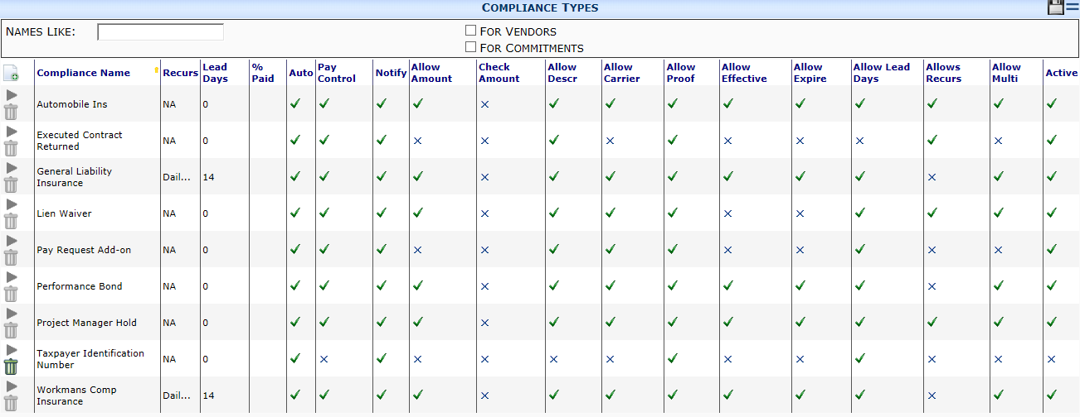
Compliance Types
User Defined
Ships with Spitfire
Note: Taxpayer Identification is linked to Dynamics SL | Vendor Maintenance

Slide 10
Alerts and Compliance Notifications
Alerts
Triggered by Alert Subscriptions
Sent to “contacts with an Alert Subscription
Routees on the Document can be included
Compliance Notifications
Triggered by “Out of Compliance
Recur set on the Compliance Type
Routed to individuals listed on the Predefined Route for Compliance Notifications
Text (by Compliance Type) controlled in the ComplianceNotificationText rule

Slide 11
Compliance Notification Setup
Created by Workflow on the Compliance Type
Auto
Creates a Compliance Notification document
Sets the Source Contact to the Vendor
Sets the Due Date to the Compliance Item’s Required Date
Sets the Title to the Compliance Type’s Name
Creates three notes (Intro, Issue, Action) for the notification based on the ComplianceNotificationText rule
Applies the predefined route
If Recur is set:
Compliance Notification will close and create a new Compliance Notification based on the “recur” setting.
Just like an Alert that is set to “daily”, “weekly”, etc. – the Compliance Notification will be “resending” every day, every week, etc. until the Compliance Item is “in compliance”

Slide 12
ComplianceNotificationText Rule Group
ComplianceNotificationText rules
Introduction
Notification
Action
If your text is too long for one row – use a $+ to indicate more text
Continue your line item with a .01 and the a .02 (Notification.01 above)

Slide 13
Compliance Text “parameters”
Your text can also include the following placeholders:
\n = a new line.
$$ComplianceAmount$ = the compliance item amount, if any (see \?…\? below).
$$ComplianceCarrier$ = the compliance item carrier, if any (see \?…\? below).
$$ComplianceDescription$ = the compliance item description.
$$ComplianceDue$ = the compliance item “required by” date and time.
$$ComplianceExpiration$ = the compliance item expiration date, if any (see \?…\? below)
$$ComplianceName$ = the compliance type name
$$ComplianceRoute$ = the text in the WorkflowRouting rule (below).
\?…\? = remove this section if it contains any empty replacements.
And don’t forget
Add a Predefined Route
Add a Template Suggestion: EmailBody template type

Slide 14
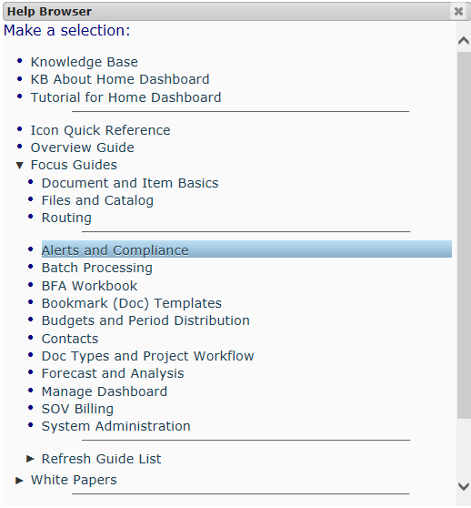
Resources
Focus Guide: Alerts and Compliance on the Help menu in Spitfire

Slide 15
Next Topic
Workflow Library The New Superhero
Thursday August 11th – 1:00 pm EST
Review past Webinars at http://support.spitfirepm.com
Have a topic you’d like included in an upcoming Webinar?
Send your suggestion to dmcgovern@spitfiremanagement.com

